Slide 1
Road Traffic Collisions
Predictive Analysis

Slide 2
INTRODUCTION
Study was conducted using data provided by cambridgeshire county.
Predictive analysis of fatal road accidents
A1 Insurance company is sponsor for auto underwriting
Multiple factors need consideration for this analysis
This included road conditions, weather, visibility and speed limit

Slide 3
Data description
The road traffic collisions data from 2018 was selected
This file was formatted in comma separated values (csv)
This data set consisted of pertinent information such as fatal severity, road conditions, weather, speed limit and road number (identification).
Several string objects need conversion into integer.

Slide 4
Methodology
Program was coded in python, using jupyter notebook on ibm Watson.
Four objects required data prepping from a string format into an integer.
Two regression methods were utilized, logistic regression (lr) and support vector machines (svm).
The f1 score and jaccard similarity were calculated to determine model accuracy.

Slide 5
results
The f1 score and jaccard similarity scores did not generate high accuracy scores.
 | F1 Score | Jaccard Similarity
Logistic Regression | 0.6076 | 0.7236
Support Vector Machine | 0.6284 | 0.7358

Slide 6
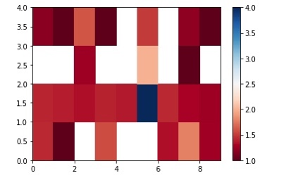
Heatmap – shows relationship of road condition and weather vs. accident severity

Slide 7
conclusion
It was difficult to draw a high accurate score of fatal accidents against data set.
the highest casualty per incident (20, 11) occurred on dry conditions during daylight, and on a fine day with no high winds.
There appeared to be more car activity during dry days, in daytime with no precipitation or high winds.
It is unclear if the drivers were reckless, distracted or under the influence. These info were not available on the data set.
It is also undetermined if the accident was caused by driver inexperience or vehicle malfunction.

